Slide 1
OPAL
Student’s Name:
Institutional Affiliation:
Course:
Date:

Slide 2
Introduction
Opals are stones with tiny crystalline spheres that seem to sparkle as they reflect light
Precious opals are known for their ‘color play’
Opals exhibit impressive color range. They can be blue, light green ,pink, milky white, black ,or gray
All precious opals are multi-colored, and the greater the color varieties , the greater the stone value
Opal comes in a variety of forms as they are mined from deposits in Brazil, Ethiopia, Australia, and other countries worldwide

Slide 3
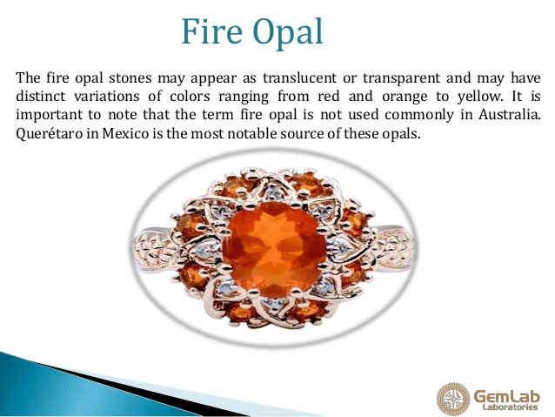
Opal Stones
Fire opal is one of the most popular opal stones that enhances the personal power and protects from dangers
It amplifies the energy and facilitates the changes

Slide 4
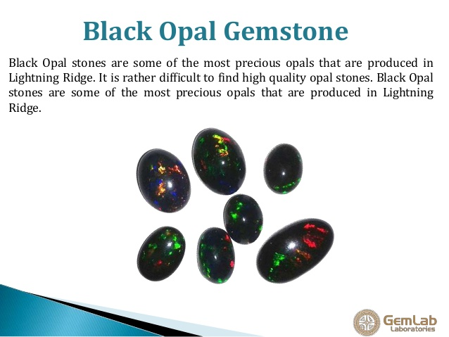
Black Opal: these are the most precious opals which are often produced in Lightning Ridge

Slide 5
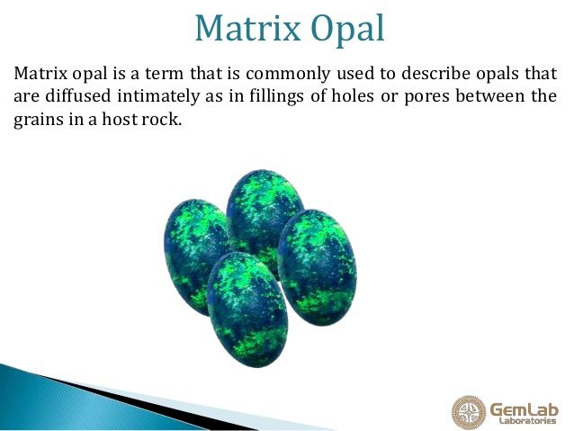
Matrix Opal : theses are intimately diffused opals as fillings of pores and holes in the host rock

Slide 6
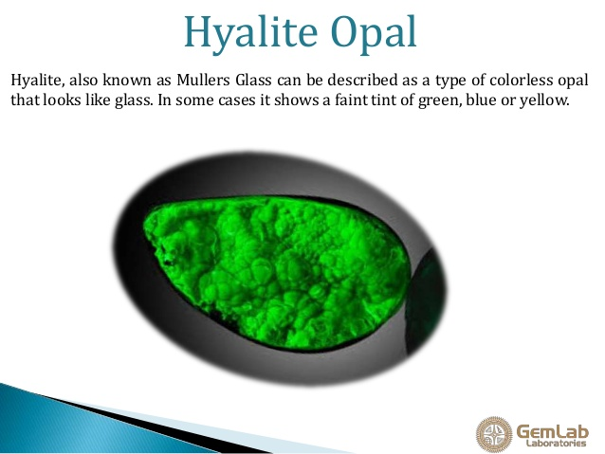
Hyalite Opal Hyalite: these are colorless opals which look like glasses
They are also called Mullers Glasses

Slide 7
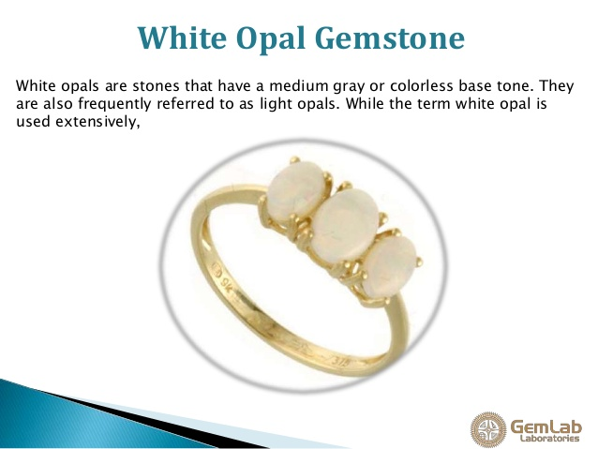
White opals: These are opal stones which have a medium colorless or gray base tone
They are also called light opals

Slide 8
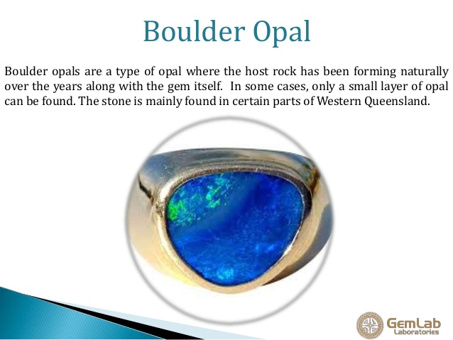
Boulder opals : These are opals in which the host rock has been naturally forming along with the gemstone over the years
The Boulder opals are only found in some regions of Western Queensland

Slide 9
Uses of Opals
Large Opals with high quality play-of-color are cut and utilized in the production of valuable gemstones and other items
Opal has proved to be one of the most wonderful stones for brooches, earrings, as well as pendants
Different items of jewelry produced from Opal does not undergo significant abrasion
Opal is used to make a ring, designers ensure that the stone is fully protected by a bezel

Slide 10
Origin, Rarity of Opals
The host rock determines what constitutes a given Opal’s geochemistry
The main impurities in Opal include: Pb, Al, Zr, Ca, Sr, Na, and U, Fe, and K
Sedimentary Opals are made up of Ba N 110ppm and Ce and Eu anomalies, while their volcanic counterparts comprise Ba b 100pp
The greater Fe concentrations induce darker colors, while low U content causes a green luminescence
Some Opals feature internal structures that look like regularly packed spheres, which, in turn, enable these gems to diffract grate and separate different amounts of light in a variety of component colors

Slide 11
Conclusion
Most Common Opals rarely appeal to commercial attention, but they are often cut into stones and polished to produce gemstones of beauty

Slide 12
References
Books, C. (2019). Opal: October birthstone notebook. Blank Lined Soft Cover Journal, 1-120.
Gaillou, E., Delaunay, A., Rondeau, B., & Bouhnik-Le-Coz, M. (2008). The geochemistry of gem opals as evidence of their origin. Ore Geology Reviews, 34(1), 113-126.
King, H. (2020). Pictures of Opal. https://geology.com/gemstones/opal/
Rondeau, B., Fritsch, E., Mazzero, F., & Guthier, J. (2010). Play-of-color Opal from Wegel Tena, Wollo Province, Ethiopia. Gems and Gemology, 46(2), 90-105.

Slide 13
THANK YOU

